Slide 1


Look back 5
UNIT 5

Slide 2
Let’s revise!
Revise the Past Continuous.
https://wordwall.net/play/12603/129/589
Vocabulary time!
Drag and drop words into blank spaces within a text.
https://wordwall.net/play/12067/025/345

Slide 3
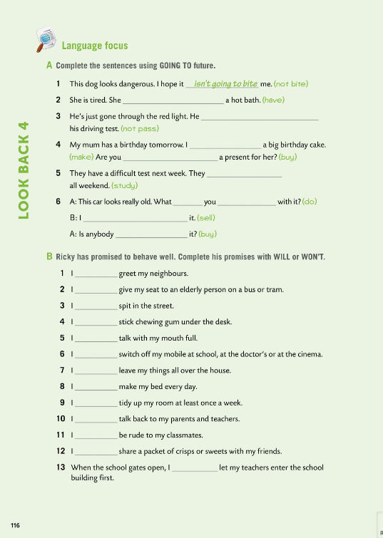

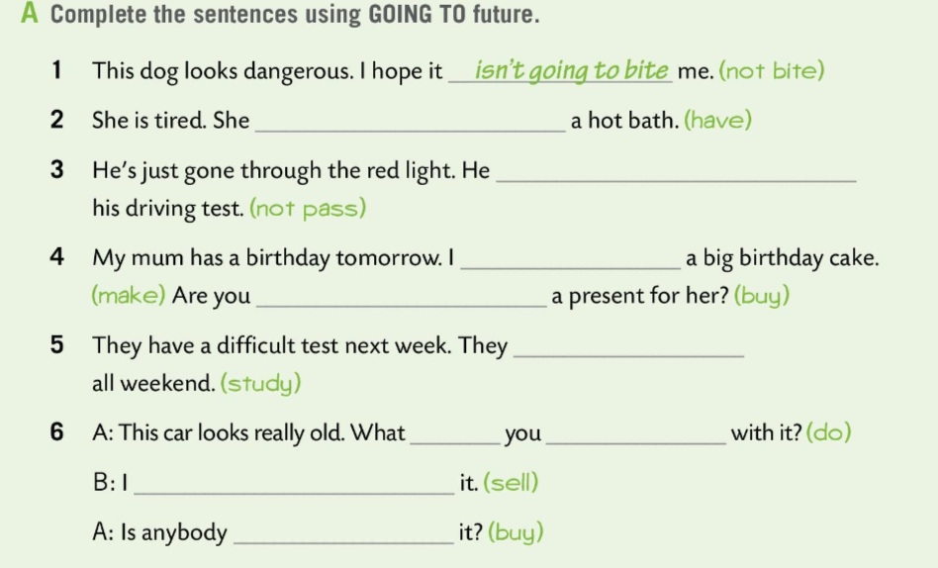
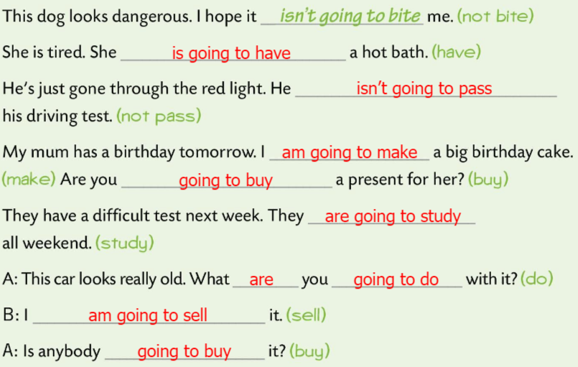
Workbook, page 116. LOOK BACK 5
Complete the sentences in Task A using GOING TO future.
Check.

Slide 4
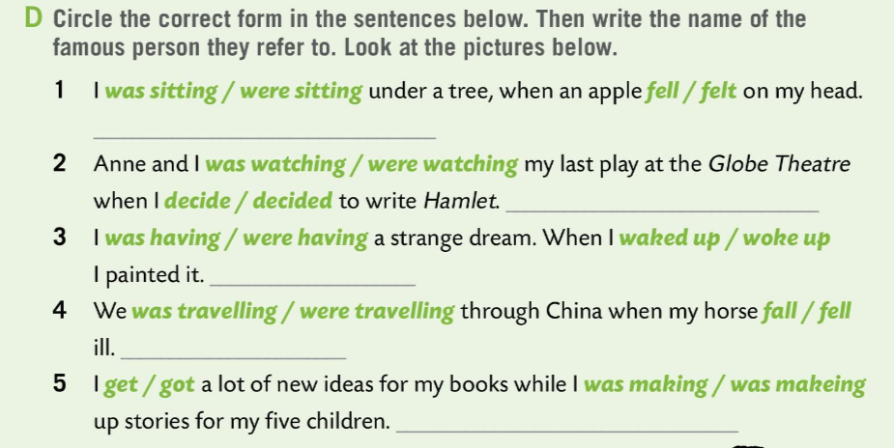
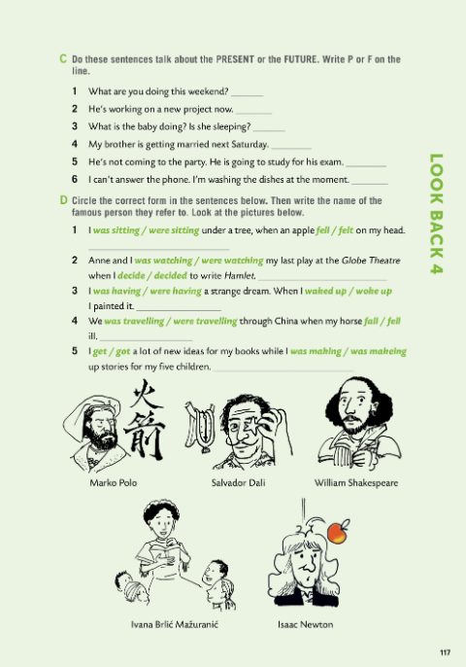
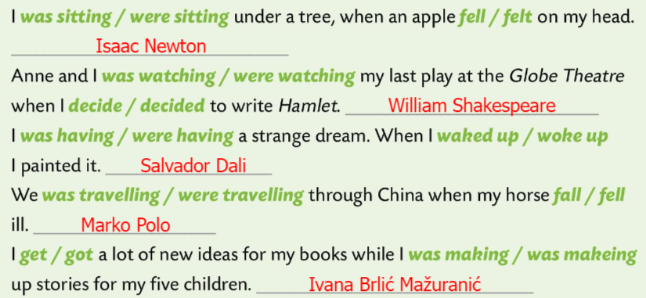
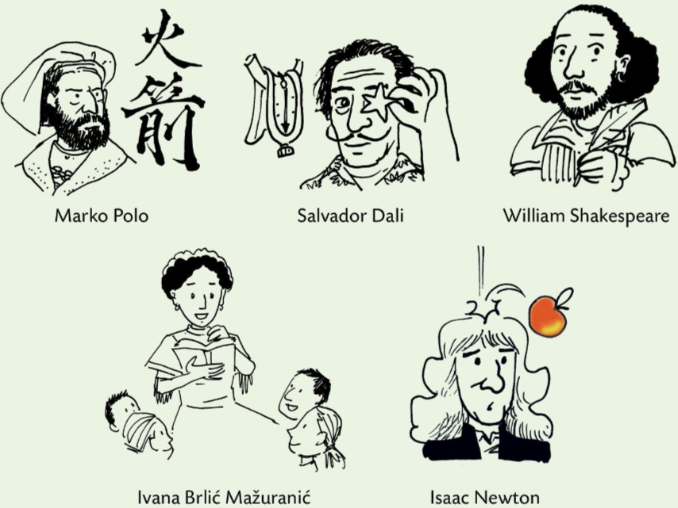
Workbook, page 117. LOOK BACK 5
Do Task D. Circle the correct form. Write the name of the famous person they refer to.
Look at the pictures below.
Check.

Slide 5
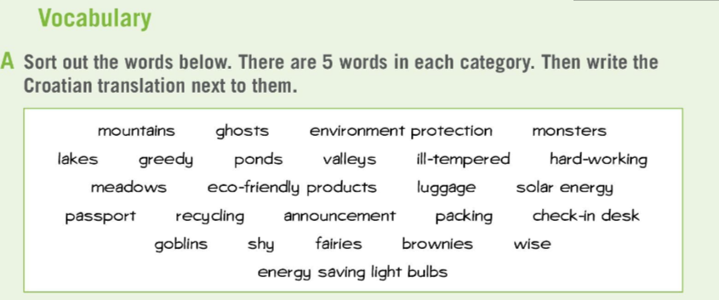
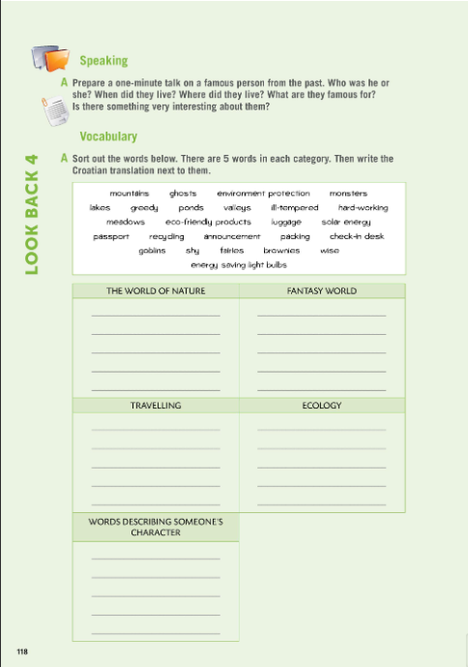
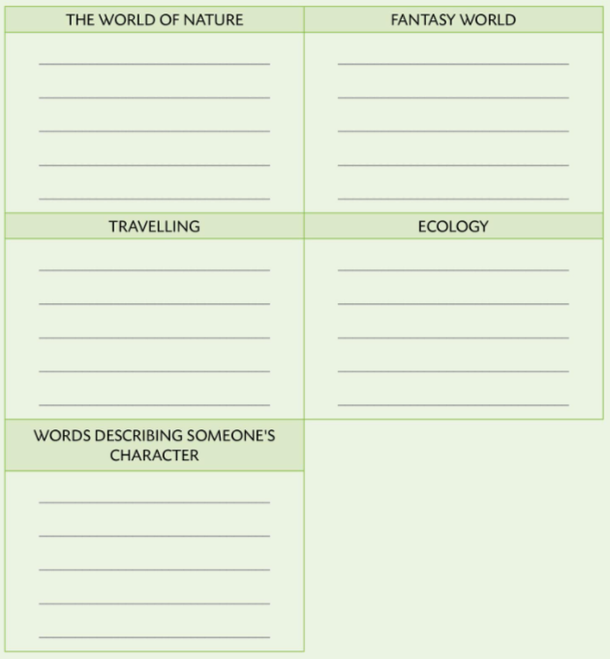
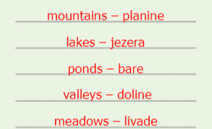
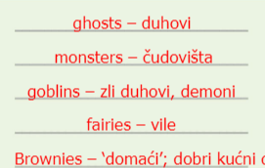
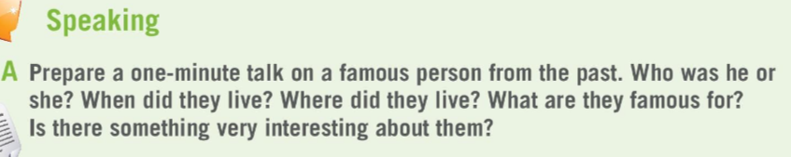
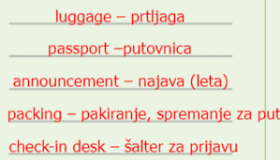
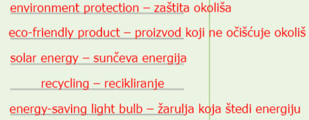
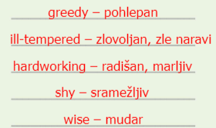
Workbook, page 118. LOOK BACK 5
Prepare a one-minute talk on a famous person from the past.
Who was he/she? When did he/she live? Where did he/she live? What is he/she famous for? Is there something interesting about him/her?
Sort out the words in Task A. There are 5 words in each category.
Translate.
Check.

Slide 6
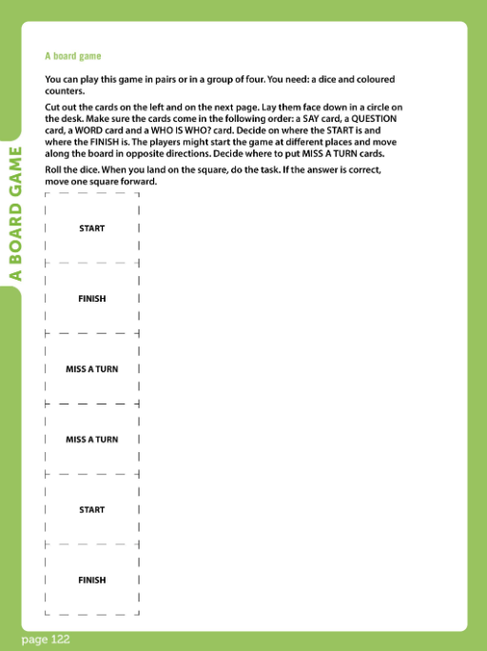
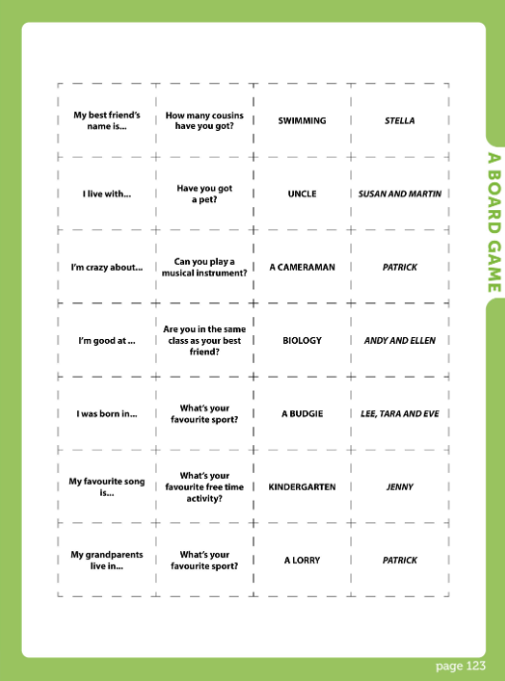
Workbook, page 122, 123 & 124.
Play this board game in groups of four. You need a dice and coloured counters.
Follow the rules in the workbook, cut out the cards and play the game.
Enjoy! ☺

